Slide 1
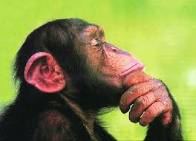
Sometimes a Confusion
AP Psychology Test Prep

Slide 2
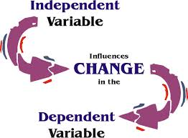
Independent and Dependent Variables

Slide 3
Two groups play video games
one group violent, one nonviolent.
Next the researchers measure
incidents of violent behavior.
Independent Variable: Type of video game assigned.
Dependent Variable: Incidence of
violent behaviors.

Slide 4
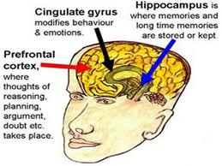
Use mnemonic tips to remember the
functions of
different parts
of the brain.

Slide 5
For “hippocampus”, think campus
The hippocampus forms and retrieves memories.
You will form many memories on
your college campus and they will be stored in your hippocampus.

Slide 6
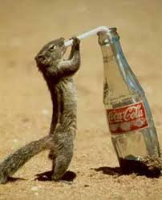
Hypothalamus:
Notice the letters H and T to help
you remember that the
The hypothalamus controls Hunger and Thirst.
Also remember the
Four F’s as functions
of the hypothalamus.

Slide 7
Remember that the Left Cerebral Hemisphere is responsible for
Language functions:
Connect the L in Left with the L in the word Language.

Slide 8
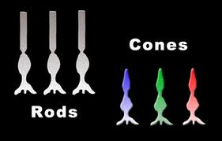
You won’t have to label a diagram of the eye, but you should know about RODS and CONES.
Connect the C in the word CONES with the C in the word COLOR.
Once you know CONES are responsible for Color vision, you’ll know that RODS deal with night shades of grey – no color

Slide 9
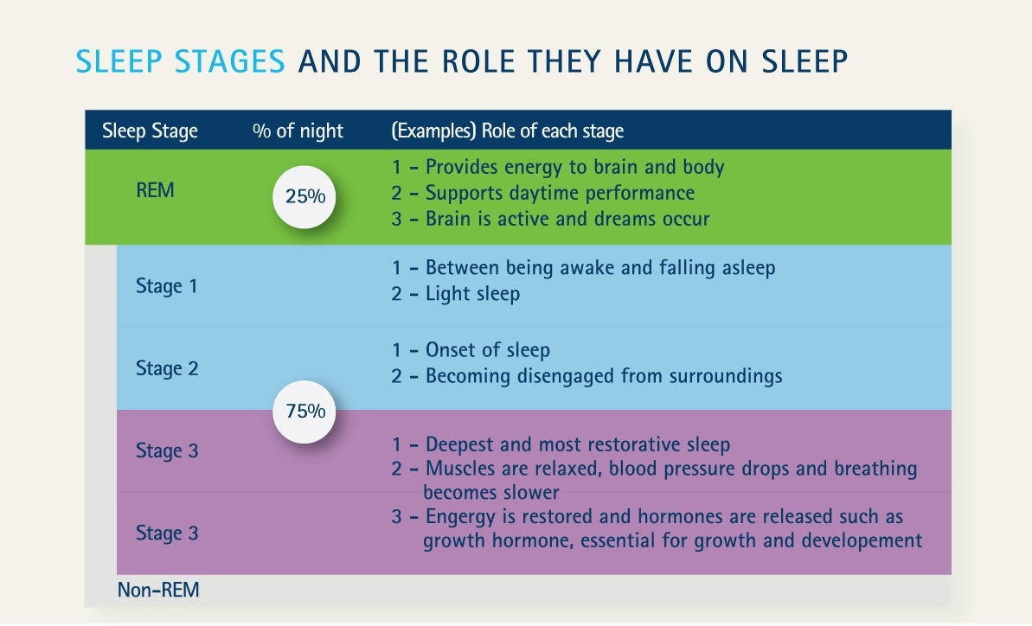

Slide 10
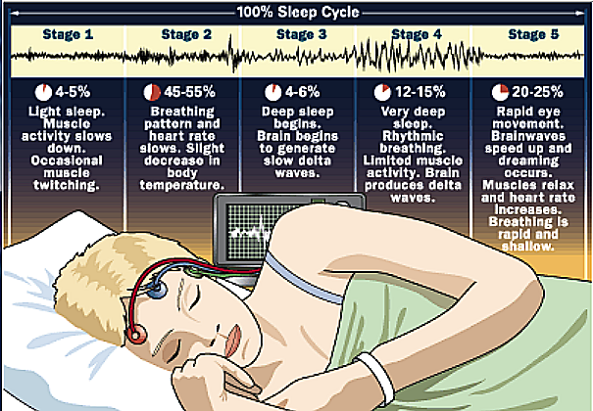

Slide 11
Important Information about the sleep cycle:
1. REM sleep does not begin immediately.
Sleep begins with four NREM stages that last an hour.
After stage four, the sleeper goes back through
Stages 3 and 2 and then enters REM sleep.
The amount of REM sleep changes during a lifetime.
REM sleep is highly
correlated with
dreams

Slide 12
The James-Lange Theory of Emotion vs. the Schacter-Singer two-factor theory of emotion.
Schacter-Singer TWO-factor theory has a component the James –Lange
Theory does not have, COGNITIVE LABELING.
Think: Schacter-Singer has the number TWO in it, it has more than James
Lange. The added component is COGNITIVE LABELING

Slide 14
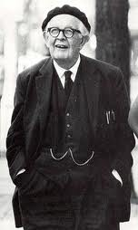
Key characteristics of the stages in Piaget’s Theory of
Cognitive Development

Slide 15
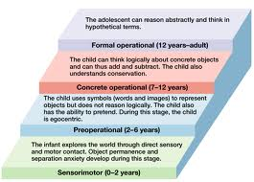

Slide 16
Test reliability: A test can be used over and
over and will continue to
get the same results.

Slide 17
Test validity:
A test really measures what it is intended to measure.
A test can be reliable and not valid
at the same time. You can get the
same results (reliability) on a test
that is not measuring what it says
it is going to measure. (validity)

Slide 19
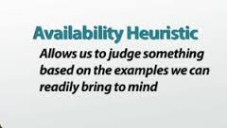
People make a judgment based on how many times they
have heard about or encountered something themselves.
they use the information available in their own experience.
People who read more case studies of successful businesses
may judge the probability of running a successful business
to be greater.

Slide 20
Representative Heuristic:
You use a representative sample
of something to make a judgment
Example: You meet three brilliant, athletic
students from a certain school and assume
that all students at that school are also
brilliant and athletic.

Slide 21
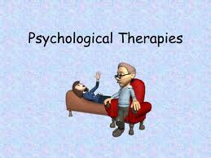

Slide 22
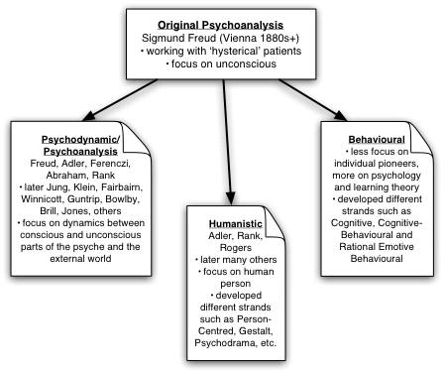

Slide 23
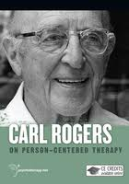
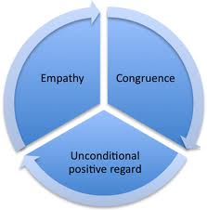
Humanist approaches to therapy :
Focus: Removing obstacles that block personal growth and potential
Major Techniques: Empathy, unconditional positive
regard, genuineness, and active listening.

Slide 24
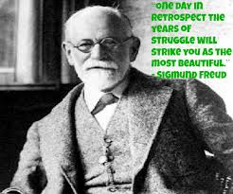
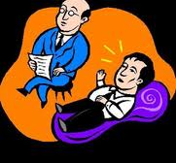
Psychoanalytic Approach:
Focus: Unconscious conflicts that usually date back to childhood experiences
Major Techniques: Uses free association, dream analysis, transference, and interpretation.

Slide 25
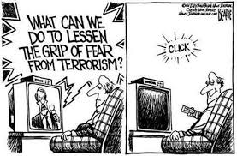
Cognitive Therapy:
Focus: Faulty thought processes and beliefs.
Major Techniques: Rational examination of
Irrational beliefs.

Slide 26
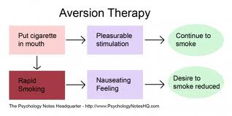
Behavioral Therapy:
Focus: Relationships between past learning and the occurrence of a behavioral problem.
Major Techniques: Systematic desensitization and aversion therapy.

Slide 27
The Fundamental
Attribution Error
vs.
The Self-Serving Bias

Slide 28
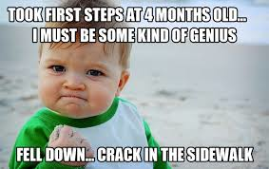
Self-Serving Bias:
How you interpret your own behavior.
Most people take credit for their own
success while blaming their failures
on circumstances beyond their control.

Slide 29
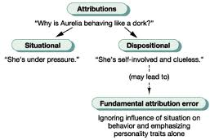
Fundamental Attribution Error:
How you judge the reasons for another person’s
behavior.

Slide 30
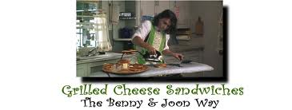
Functional Fixedness:
An inability to think outside the box.
People are often very limited in the ways they think about objects, concepts, and people. When something is thought of only in terms of its functionality, then the person is demonstrating functional fixedness. This type of thinking is narrow and limited, often inhibiting the problem solving process.

Slide 31
Positive and Negative Reinforcement:
Method for increasing positive behavior,
or decreasing negative behavior.

Slide 32
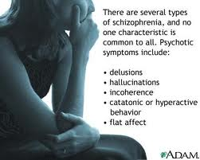
Schizophrenia:

Slide 33
Schizophrenia:
Most frequently tested form of abnormal behavior
Typically begins in late adolescence or early adulthood.
Rarely emerges prior to adolescence or after age 45.
Genetics affects your chances of having schizophrenia.

